Slide 1
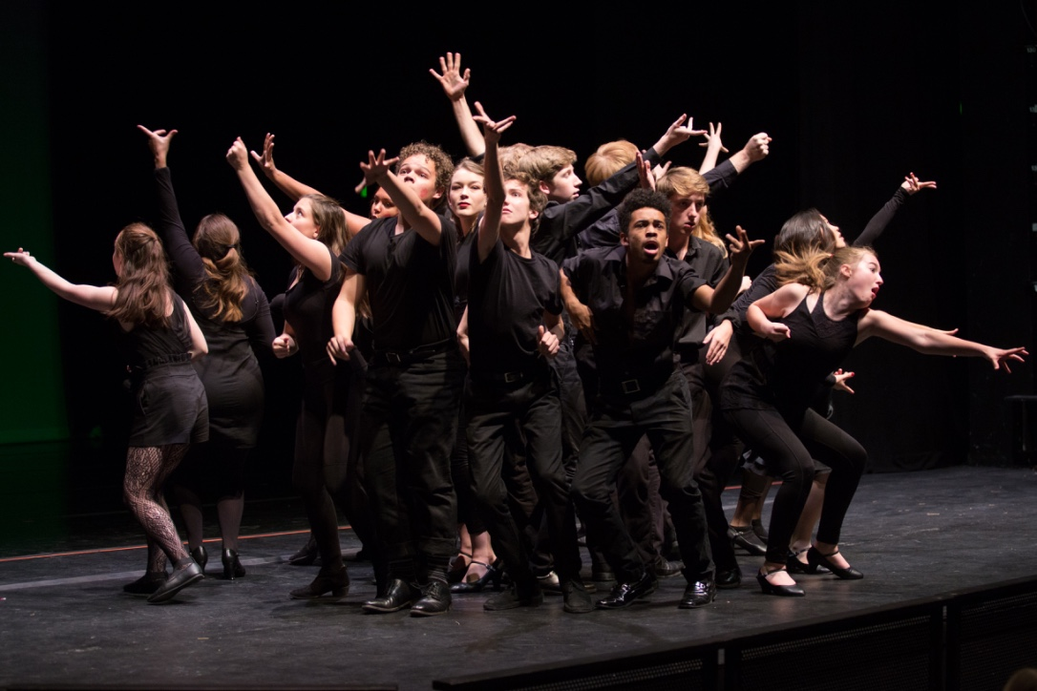
DSA Preview 2019
We’re glad you’re here. We will begin at 7:45 am – allowing our guests time to park and get inside the school.
Please move to the right in your row – leaving no empty seats. We will have a very full house this morning.
Si se necesita una traducción, favor de agarrar los auriculares en el escenario a las 7:40am.

Slide 2
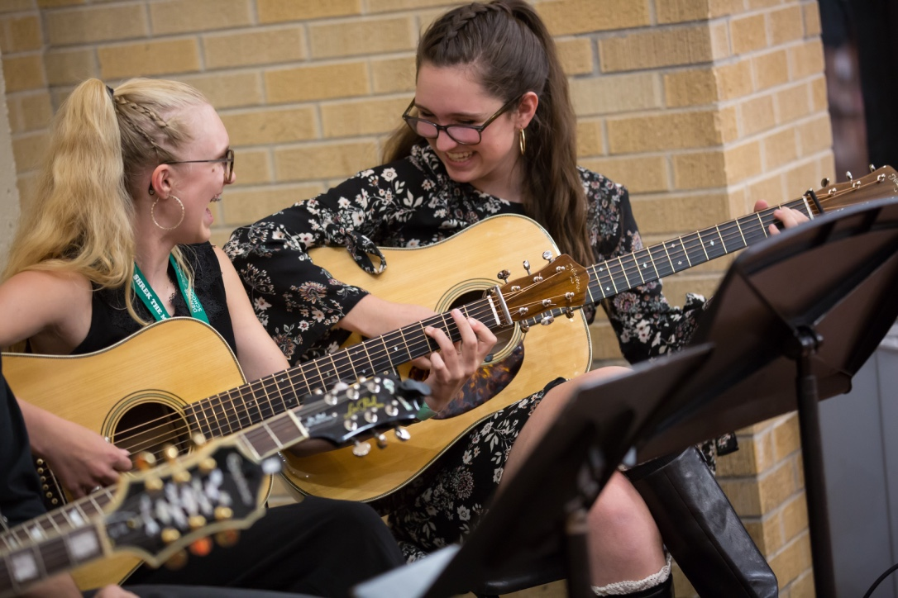
Introductions
Anthony McWright – principal
Anna Conley – assistant principal
Aspen Burkett – assistant principal IEP or 504 questions will go to Ms. Burkett If your student’s 504 or IEP has accommodations that would impact your student’s audition, Ms. Burkett will need a copy of the accommodations page one week before your student’s audition
Miranda Odom – assistant principal Director of Admissions

Slide 3
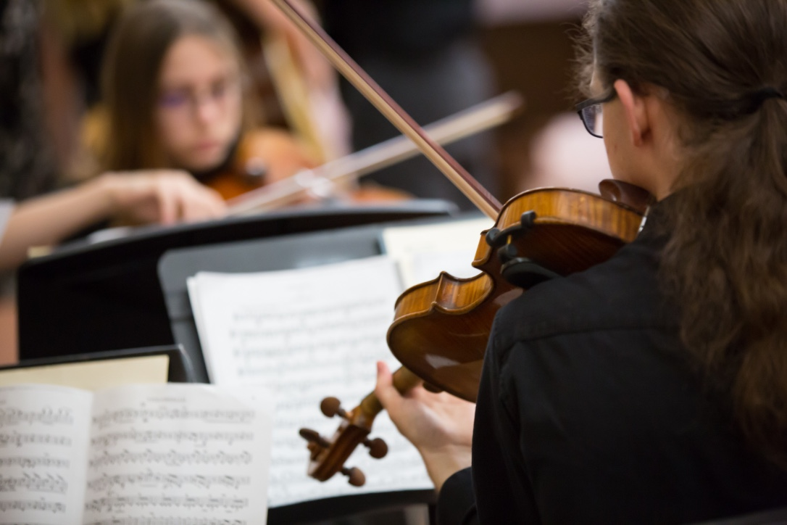
This Powerpoint
This powerpoint will be posted on the DSA Homepage on Wednesday, December 11th after the final DSA Preview is complete.
Look under “News Updates”

Slide 4
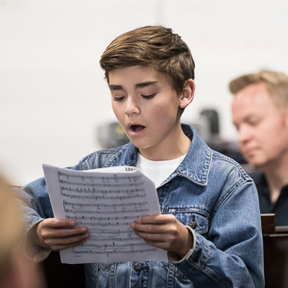
Last Year’s Audition/Acceptance Data
861 students applied
642 students completed the audition process
257 students were accepted

Slide 5
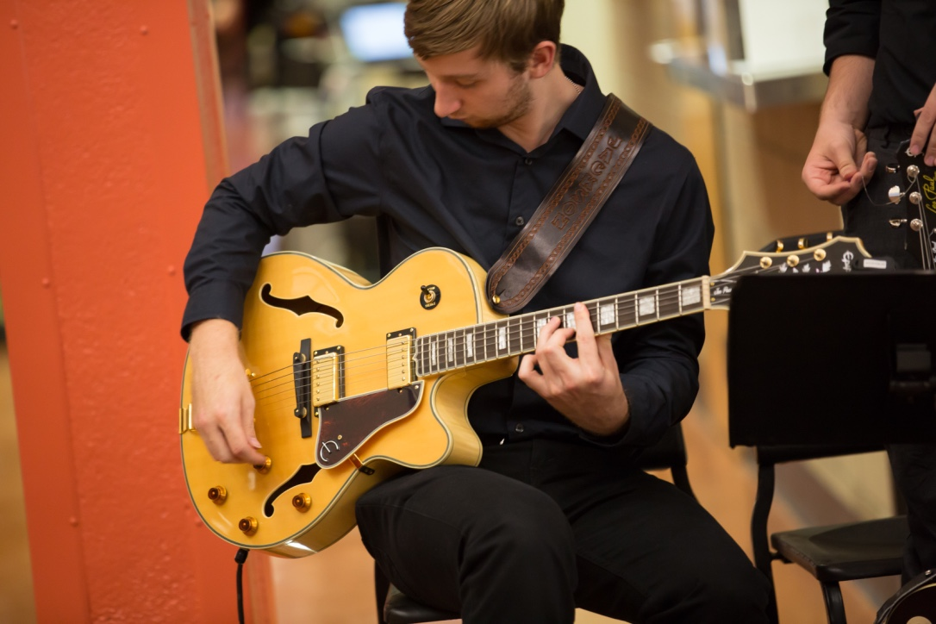
2019 Current Numbers
 | 6 | 7 | 8 | 9 | 10 | 11 | 12
Visual Arts | 15 | 17 | 17 | 23 | 19 | 19 | 16 | 126
Video | 11 | 16 | 17 | 13 | 13 | 11 | 15 | 96
Stagecraft | 0 | 0 | 0 | 12 | 18 | 14 | 18 | 62
Dance | 22 | 22 | 20 | 23 | 21 | 18 | 15 | 141
CW | 12 | 11 | 16 | 16 | 19 | 15 | 18 | 107
Band | 14 | 13 | 9 | 13 | 22 | 17 | 21 | 109
Orchestra | 14 | 16 | 12 | 19 | 14 | 16 | 14 | 105
Vocal | 17 | 10 | 19 | 17 | 16 | 11 | 12 | 102
Theatre | 18 | 17 | 23 | 31 | 22 | 28 | 31 | 170
Piano | 7 | 8 | 8 | 7 | 6 | 4 | 6 | 46
Guitar | 5 | 9 | 9 | 7 | 3 | 4 | 10 | 47
 | 135 | 139 | 150 | 181 | 173 | 157 | 176 | 1111
88 students applied
99 students completed the audition process
88 students were accepted

Slide 6
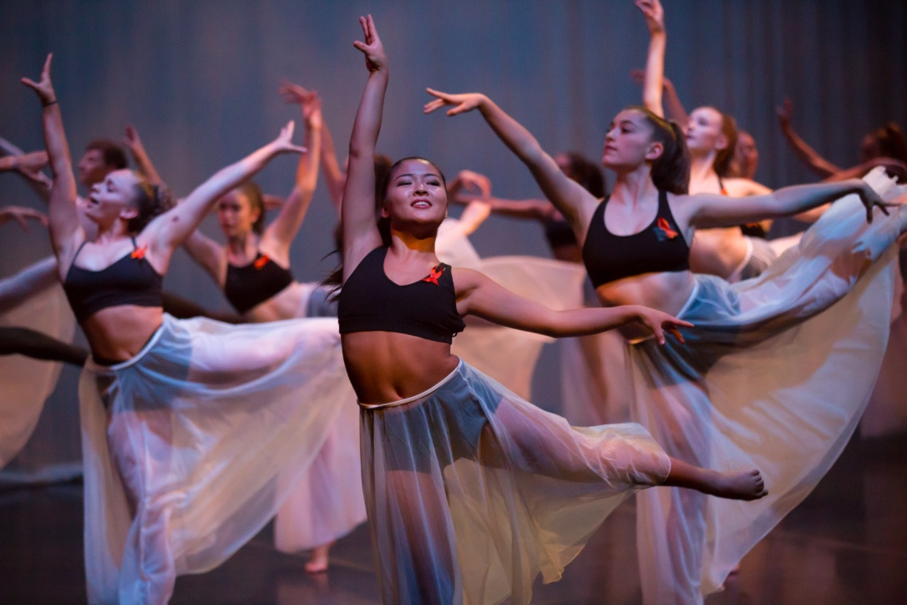
2019 Audition/Acceptance Data
For the 2020-2021 school year we know that we will accept 136
6th graders

Slide 7
2019 Audition/Acceptance Data
For the 2020-2021 school year we know that we will accept 136
6th graders
Students auditioning for entrance into the 7th grade will be auditioning for the waitlist only.

Slide 8
2019 Audition/Acceptance Data
For the 2020-2021 school year we know that we will accept 136
6th graders
Students auditioning for entrance into the 7th grade will be auditioning for the waitlist only.
Stagecraft and Design only enrolls high school students

Slide 9
2019 Audition/Acceptance Data
For the 2020-2021 school year we know that we will accept 136
6th graders
Students auditioning for entrance into the 7th grade will be auditioning for the waitlist only.
Stagecraft and Design only enrolls high school students
DSA’s current enrollment is 1111:
682 females and 429 males

Slide 10
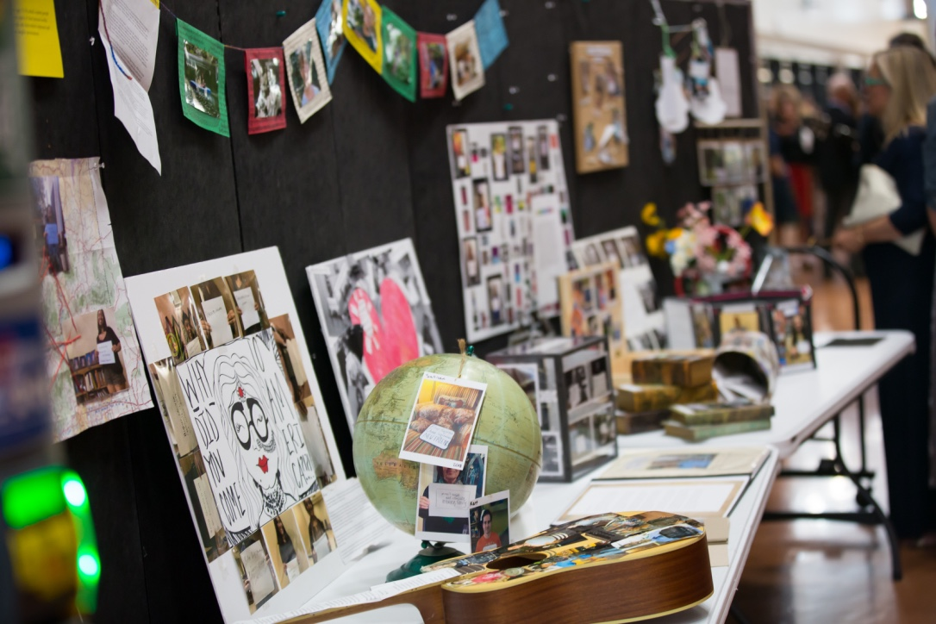
2019 Audition/Acceptance Data
Typically speaking:
Our biggest acceptance class is 6th grade

Slide 11
2019 Audition/Acceptance Data
Typically speaking:
Our biggest acceptance class is 6th grade
Our 2nd biggest acceptance class is 9th grade

Slide 12
2019 Audition/Acceptance Data
Typically speaking:
Our biggest acceptance class is 6th grade
Our 2nd biggest acceptance class is 9th grade
Our 3rd biggest acceptance class is 8th grade

Slide 13
2019 Audition/Acceptance Data
Typically speaking:
Our biggest acceptance class is 6th grade
Our 2nd biggest acceptance class is 9th grade
Our 3rd biggest acceptance class is 8th grade
7th grade is waitlist only – therefore our smallest class

Slide 14
2019 Audition/Acceptance Data
Typically speaking:
Our biggest acceptance class is 6th grade
Our 2nd biggest acceptance class is 9th grade
Our 3rd biggest acceptance class is 8th grade
7th grade is waitlist only – therefore our smallest class
Grades 10 – 12 vary from year to year

Slide 15
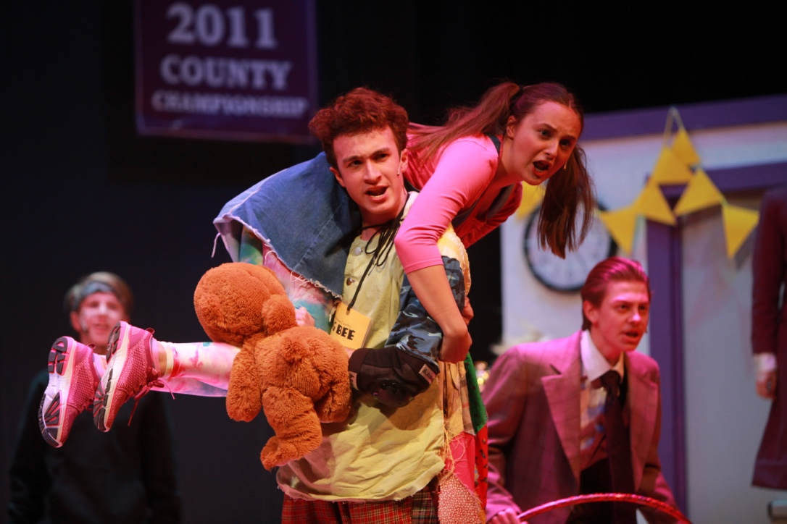
2019 Audition/Acceptance Data
We do not have a set number of accepted seats except for 6th grade.
Accept numbers are dependent on how many current students decide to leave in addition to how many accepted students decide NOT to take their seat.

Slide 16
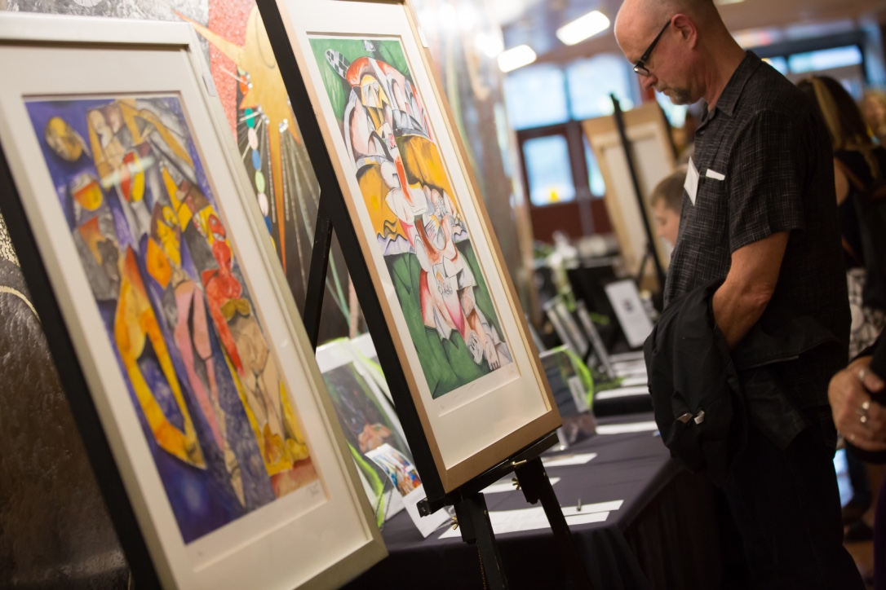
About Us
DSA is a “Blue” (Distinguished) school on the DPS School Performance Framework

Slide 17
About Us
DSA is a “Blue” (Distinguished) school on the DPS School Performance Framework
DSA has been named an Exemplary School by the Arts School Network (DSA-like schools from all over the US)

Slide 18
About Us
DSA is a “Blue” (Distinguished) school on the DPS School Performance Framework
DSA has been named an Exemplary School by the Arts School Network (DSA-like schools from all over the US)
DSA is currently ranked #2 in the state by US World and News Report.

Slide 19
About Us
DSA is a “Blue” (Distinguished) school on the DPS School Performance Framework
DSA has been named an Exemplary School by the Arts School Network (DSA-like schools from all over the US)
DSA is currently ranked #2 in the state by US World and News Report.
DSA has been a Gold Medal Winner for the past 9 years.

Slide 20
The Whole Child
Social Worker
Psychologist
4 Counselors
SSC
Ongoing Staff Training

Slide 21
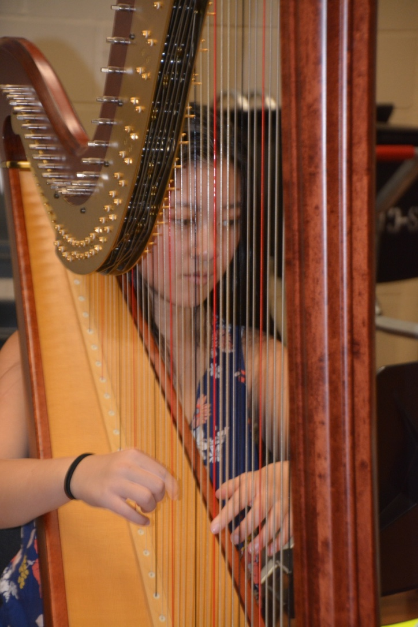
Grades 9 - 12

Slide 22
Grades 9 - 12
Our high school runs on an alternating “Black”/”White” Day schedule with four 95-minute periods in a day.

Slide 23
Grades 9 - 12
Our high school runs on an alternating “Black”/”White” Day schedule with four 95-minute periods in a day.
On Friday, we have a Stripe Day in which all students see all 8 periods for 43 minutes

Slide 24
Grades 9 - 12
Our high school runs on an alternating “Black”/”White” Day schedule with four 95-minute periods in a day.
On Friday, we have a Stripe Day in which all students see all 8 periods for 43 minutes
All students will see their arts block five days a week. They will see their academic classes (basically) every other day.

Slide 25
Grades 9 - 12
Our high school runs on an alternating “Black”/”White” Day schedule with 4 95-minute periods in a day.
On Friday, we have a Stripe Day in which all students see all 8 periods for 43 minutes
All students will see their arts block five days a week. They will see their academic classes (basically) every other day.
DSA High School has an “open campus”

Slide 26
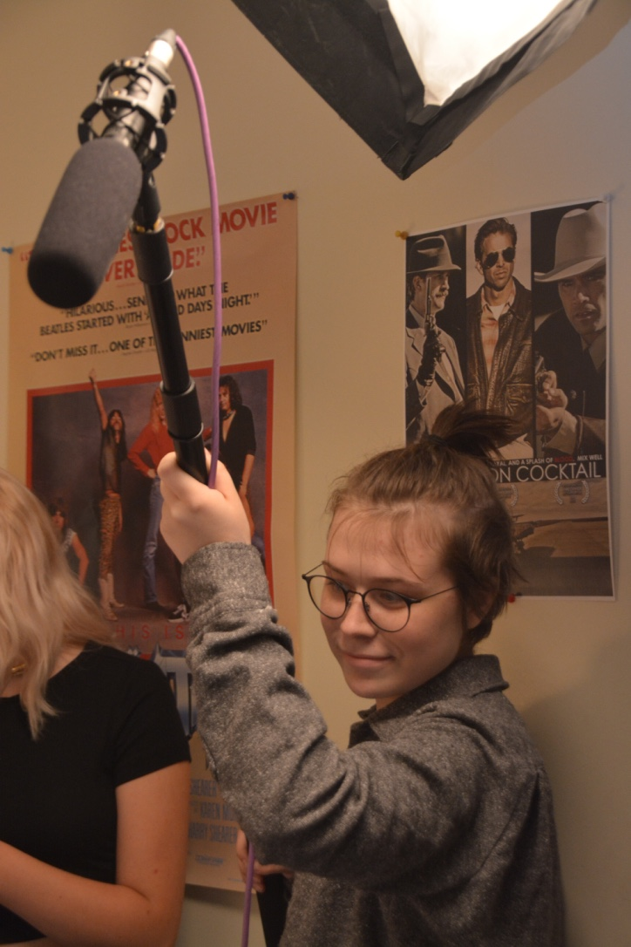
Grade 8

Slide 27
Grade 8
Grade 8 runs on the same black/white/stripe schedule as the high school

Slide 28
Grade 8
Grade 8 runs on the same black/white/stripe schedule as the high school
8th graders participate in 4 ‘wheel’ classes throughout the year. These classes are chosen for the 8th graders by our Master Scheduler Miss Odom. They are arts classes OUTSIDE of their major

Slide 29
Grade 8
Grade 8 runs on the same black/white/stripe schedule as the high school
8th graders participate in 4 ‘wheel’ classes throughout the year. These classes are chosen for the 8th graders by our Master Scheduler Miss Odom. They are arts classes OUTSIDE of their major
There is not a foreign language option for DSA Middle School students

Slide 30
Grade 8
Grade 8 runs on the same black/white/stripe schedule as the high school
8th graders participate in 4 ‘wheel’ classes throughout the year. These classes are chosen for the 8th graders by our Master Scheduler Miss Odom. They are arts classes OUTSIDE of their major
There is not a foreign language option for DSA Middle School students
We do not offer “honors” classes in our DSA Middle School

Slide 31
Grade 8
Grade 8 runs on the same black/white/stripe schedule as the high school
8th graders participate in 4 ‘wheel’ classes throughout the year. These classes are chosen for the 8th graders by our Master Scheduler Miss Odom. They are arts classes OUTSIDE of their major
There is not a foreign language option for DSA Middle School students
We do not offer “honors” classes in our DSA Middle School
DSA Middle School students have a “closed” campus

Slide 32
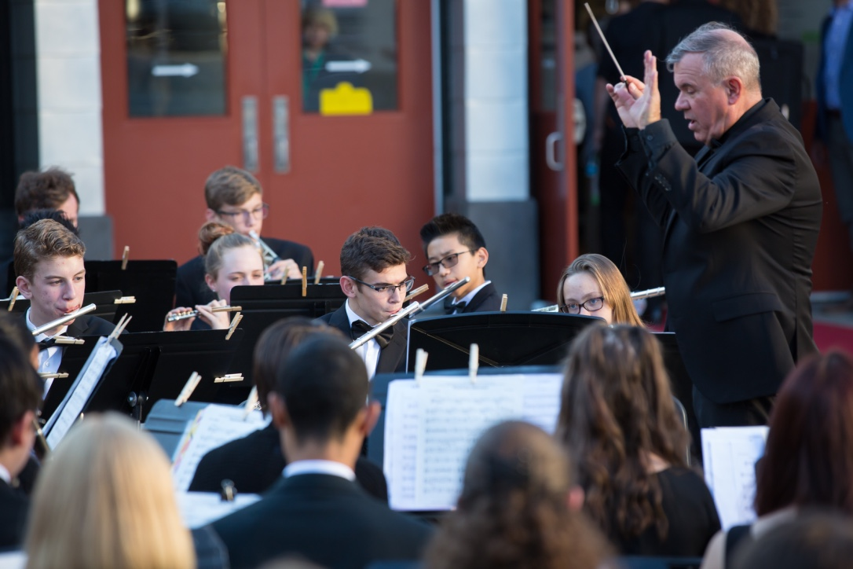
Grades 6 and 7

Slide 33
Grades 6 and 7
Grades 6 & 7 have 5 periods every day:
Language Arts, Social Studies, Math, Science and their major

Slide 34
Grades 6 and 7
Grades 6 & 7 have 5 periods every day:
Language Arts, Social Studies, Math, Science and their major
Grades 6 & 7 have a separate lunch period than grades 8 – 12.

Slide 35
Grades 6 and 7
Grades 6 & 7 have 5 periods every day:
Language Arts, Social Studies, Math, Science and their major
Grades 6 & 7 have a separate lunch period than grades 8 – 12.
We do not offer “honors” classes in our DSA Middle School

Slide 36
Grades 6 and 7
Grades 6 & 7 have 5 periods every day:
Language Arts, Social Studies, Math, Science and their major
Grades 6 & 7 have a separate lunch period than grades 8 – 12.
We do not offer “honors” classes in our DSA Middle School
There is not a foreign language option for DSA Middle School students

Slide 37
Grades 6 and 7
Grades 6 & 7 have 5 periods every day:
Language Arts, Social Studies, Math, Science and their major
Grades 6 & 7 have a separate lunch period than grades 8 – 12.
We do not offer “honors” classes in our DSA Middle School
There is not a foreign language option for DSA Middle School students
DSA Middle School students have a “closed” campus

Slide 38
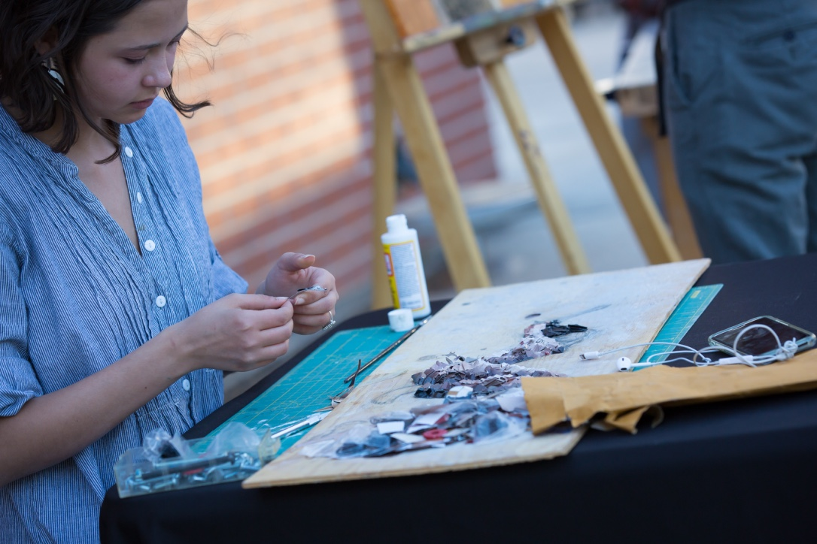
DSA Math Sequence
We will post the math sequence letter, along with this powerpoint, on the DSA website on Wednesday, December 11th. Look on the DSA Homepage under “News Updates”

Slide 39
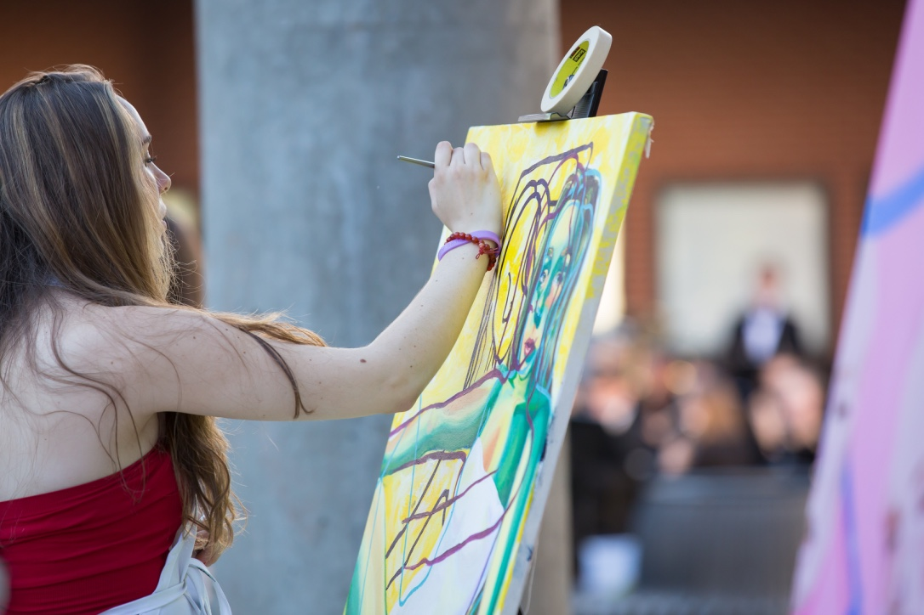
DSA Math Sequence
We do not accelerate any students in math until the 8th grade
All DSA 6th graders will take 6th Grade Math
All DSA 7th graders will take 7th Grade Math

Slide 40
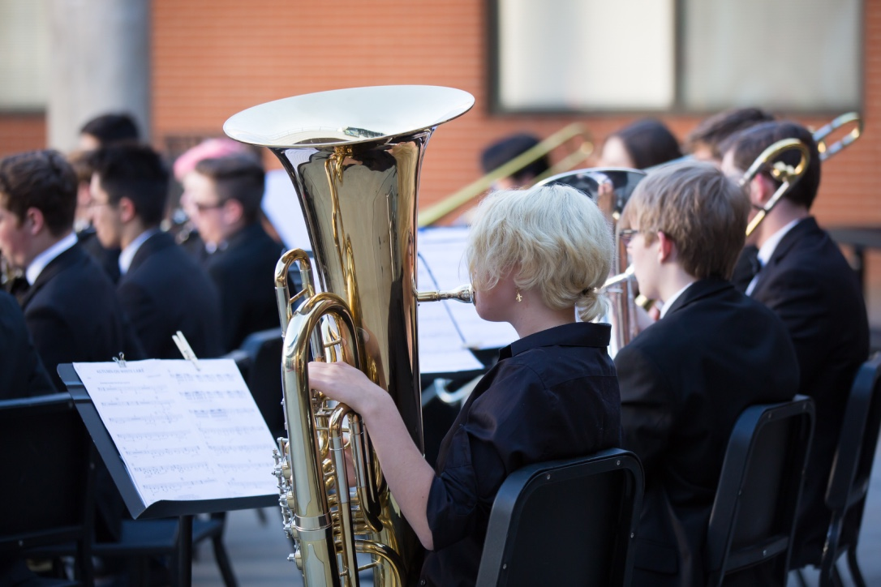
DSA Math Sequence
In the 8th grade students have the chance to take:
8th Grade Math
Math 1 (9th grade math)
Math 2 (10th grade math)
All of these placements will be determined during the spring of the student’s 7th grade year

Slide 41
DSA Math Sequence
Depending on where the student enters 9th grade math, he/she has the opportunity to take AP Calculus BC during senior year.

Slide 42
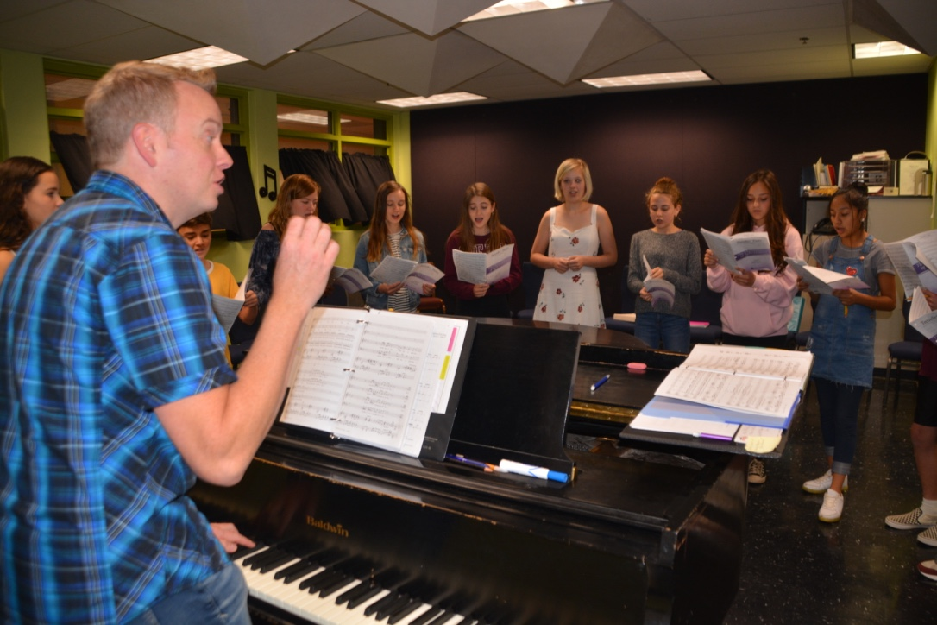
About Us
The majority of our HS academic classes have both an honors and non honors option.

Slide 43
About Us
The majority of our HS academic classes have both an honors and non honors option.
DSA currently offers 15 AP courses

Slide 44
About Us
The majority of our HS academic classes have both an honors and non honors option.
DSA currently offers 15 AP courses
11 arts majors produce over 100 performances per year

Slide 45
About Us
The majority of our HS academic classes have both an honors and non honors option.
DSA currently offers 15 AP courses
11 arts majors produce over 100 performances per year
Student travel is an important component of many of our arts programs

Slide 46
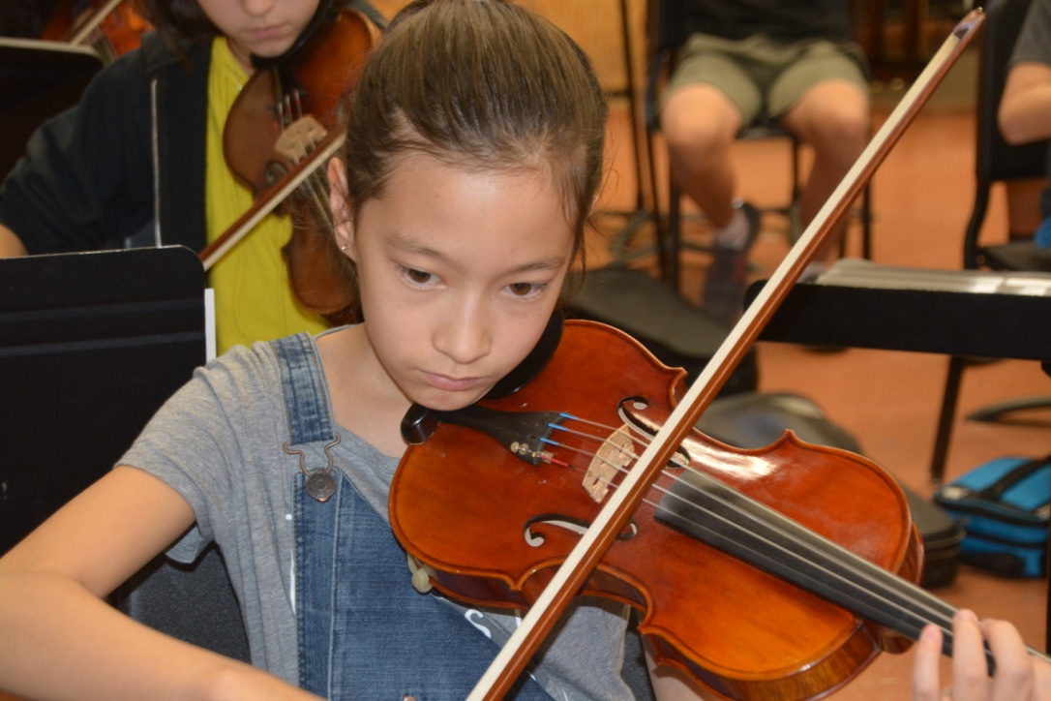
Outside the Classroom
DSA has a few afterschool clubs – although most happen over the lunch hour

Slide 47
Outside the Classroom
DSA has a few afterschool clubs – although most happen over the lunch hour
Student athletes may participate in their home school or the school closest to DSA with that particular program

Slide 48
Outside the Classroom
DSA has a few afterschool clubs – although most happen over the lunch hour
Student athletes may participate in their home school or the school closest to DSA with that particular program
Services for students with disabilities and gifted and talented students are provided at DSA

Slide 49
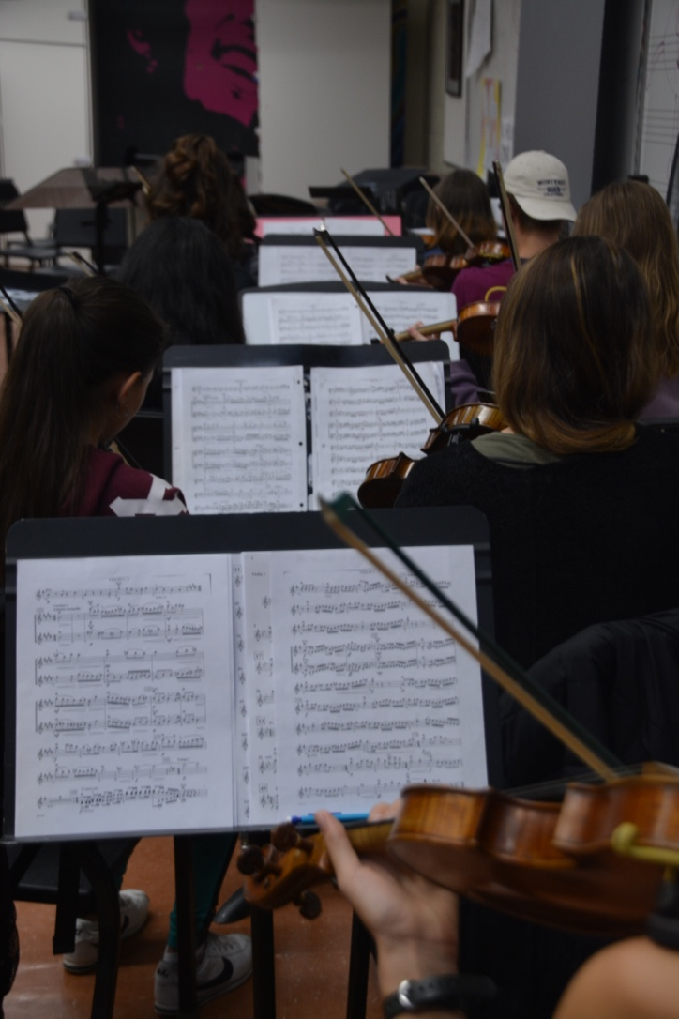
Expectations for our Artists
Students must maintain a 2.25 grade point average and a “B” in their major
Students who do not meet this requirement are placed on “watch” in January through “Watch Conferences”

Slide 50
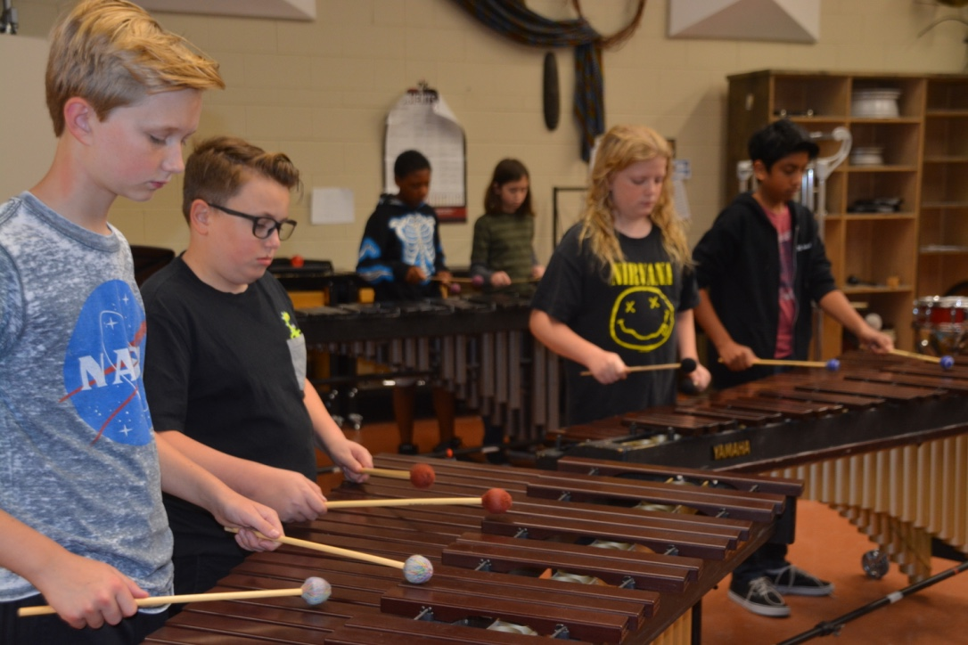
Transportation
Transportation is provided to all Denver residents by RTD or DPS yellow buses.
Bus pick up locations are determined by DPS Transportation in the summer. In the main office, there is a 19/20 bus pickup map. You can look at this map to get an idea of where our pick up locations might be for 20/21.

Slide 51
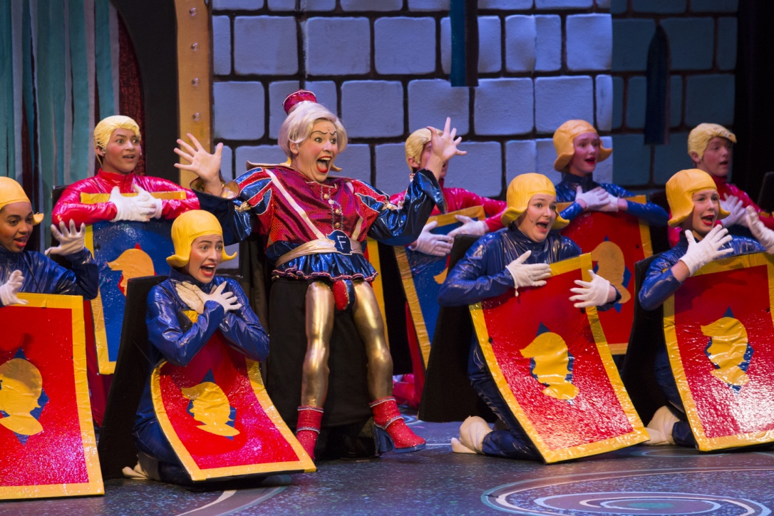
Transportation
Students who reside outside the City of Denver are responsible for providing their own transportation
DPS Yellow Buses do offer “exceptions” the summer before school starts for students outside of Denver
High school students who reside in Denver and live outside of the 3 mile walk zone will receive an RTD bus pass

Slide 52
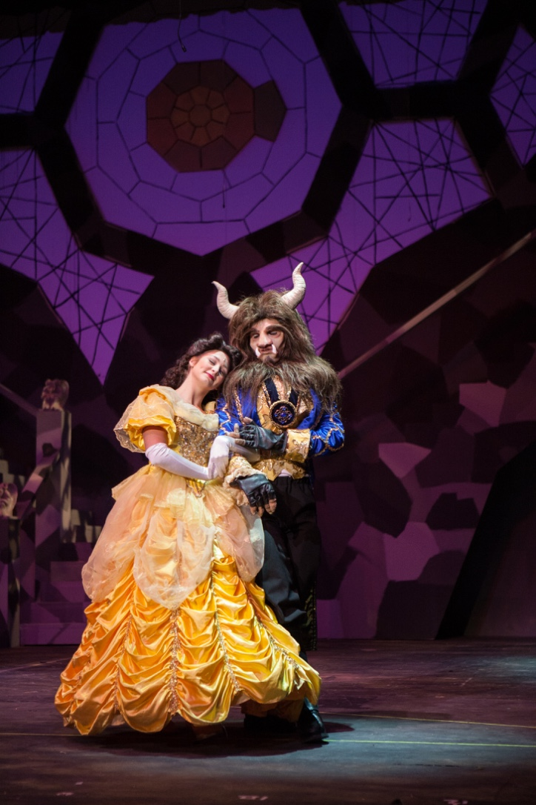
Guest & Resident Artist Program
Unique and critical to DSA’s success
Visiting Artists come for a short period of time
Resident Guest Artists are at DSA at more regular and frequent times throughout the school yer.

Slide 53
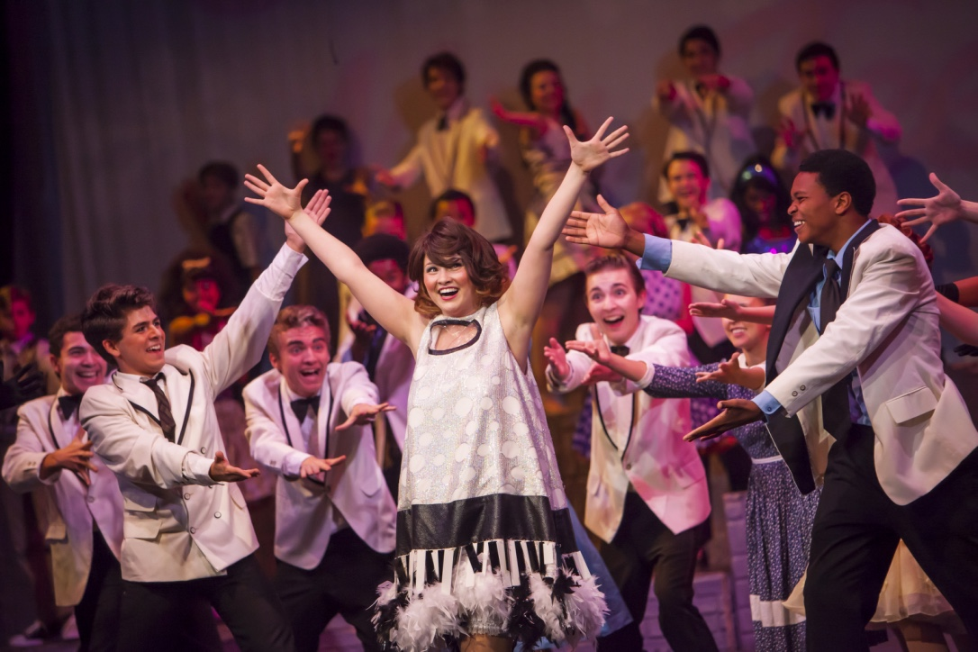
Opportunities for Parents
Opportunities exist for parents to become involved in the PTSA and Arts Parent Groups for each major
The DSA Friends Foundation hosts annual fundraising events and our Fill the Gap campaign to pay for our Guest Artist Program and other student and teacher opportunities.

Slide 54
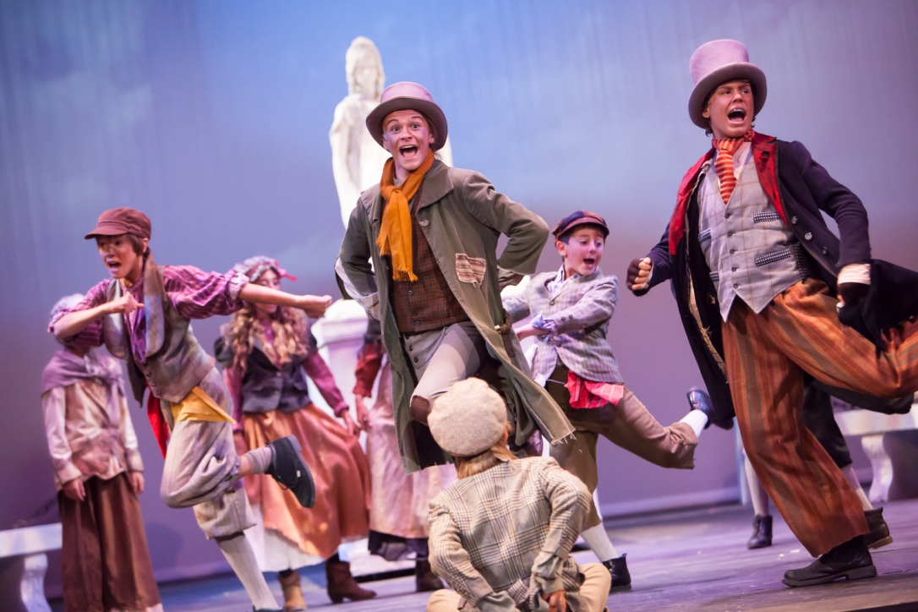
Application/Audition Process
Step 1
Apply online between November 1, 2019 and
January 3, 2020 at 9:00 am.
This will take you about 2 – 3 minutes to complete
You will receive an automatic confirmation email as soon as you submit your application. The confirmation email will go to the email you used to “create your account”
Students may only apply for and audition for one major
No late applications will be accepted

Slide 55
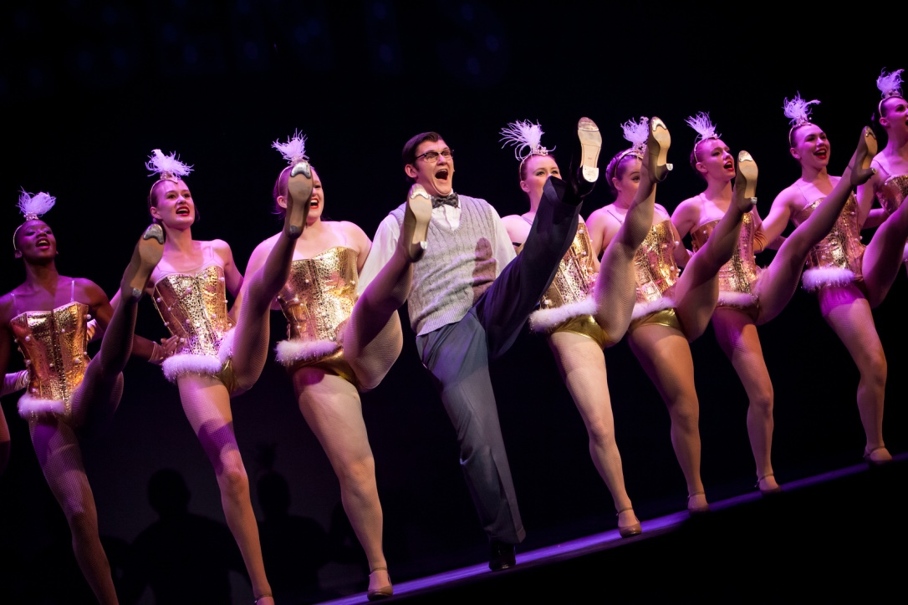
Application/Audition Process
Step 2
Attend the Mandatory Pre-Audition Meeting in January.
A parent or an adult parent designee for the applicant must be in attendance at the preaudition meeting in order to move ahead in the audition process. We allow another adult to stand in the place of the parent in case of emergencies/vacations/work/illness/etc. But an adult must be AT THIS MEETING to represent the student and get the audition information and an audition time at the end of the meeting. The student applicant does not HAVE to attend the meeting but is highly encouraged to do so.
There are no makeup meetings

Slide 56
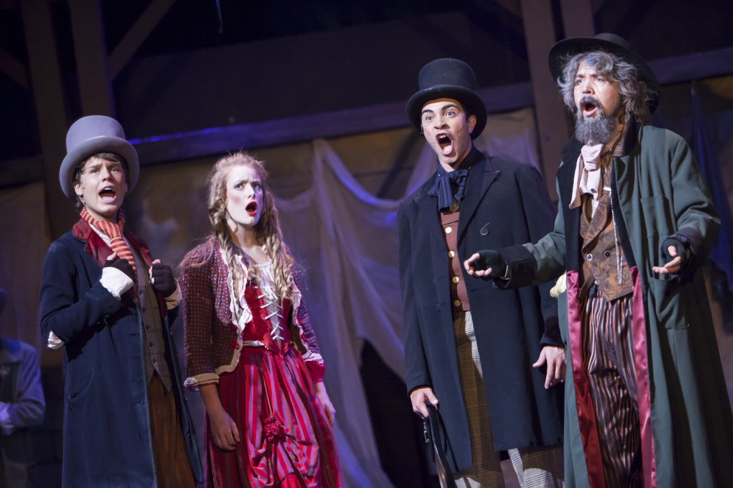
Application/Audition Process
Step 3
Complete the district “choice” process
http://schoolchoice.dpsk12.org/

Slide 57
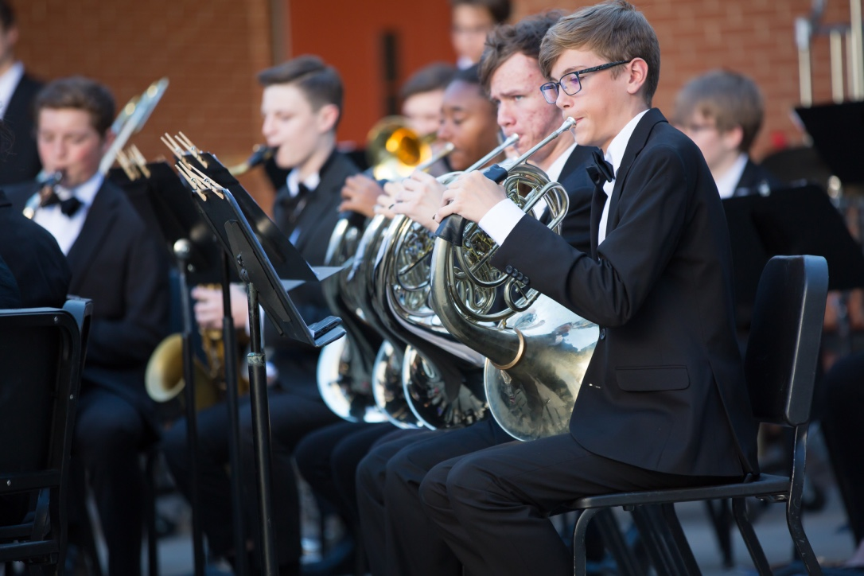
Application/Audition Process
Step 4
Audition
Your audition date and time will be given to you at your preaudition meeting in January.

Slide 58
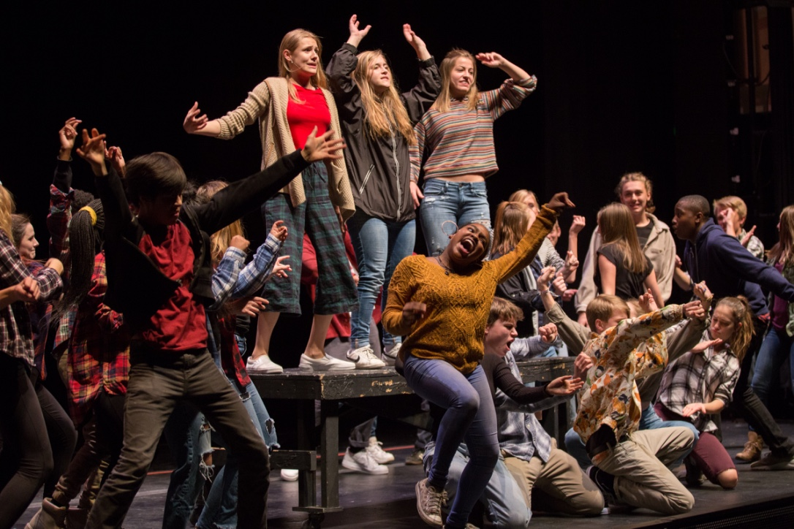
Frequently Asked Questions
Do I have to have letters of recommendations?
Do I have to have resume?
Do I have to belong to a dance studio to audition for dance?
Do I have to have private lessons to audition for and participate in Vocal Music, Band, Orchestra, Piano and Guitar?

Slide 59
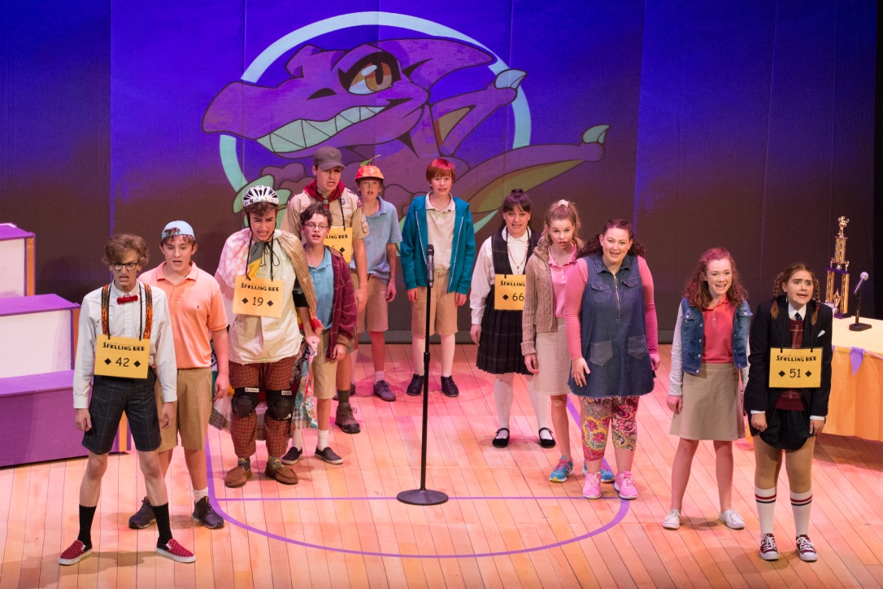
Frequently Asked Questions
All of these answers differ depending on the major.
If not answered at the Preaudition Meeting in January, ask.

Slide 60
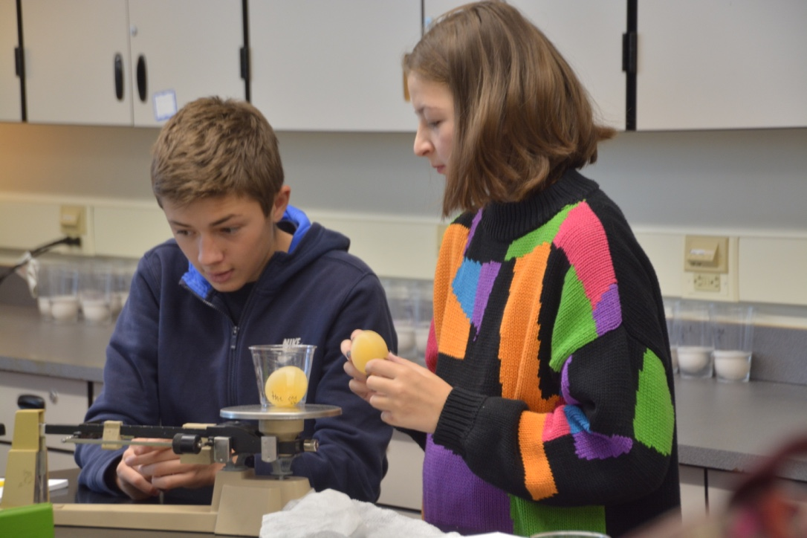
Frequently Asked Questions
Does DSA have sibling preference?
No

Slide 61
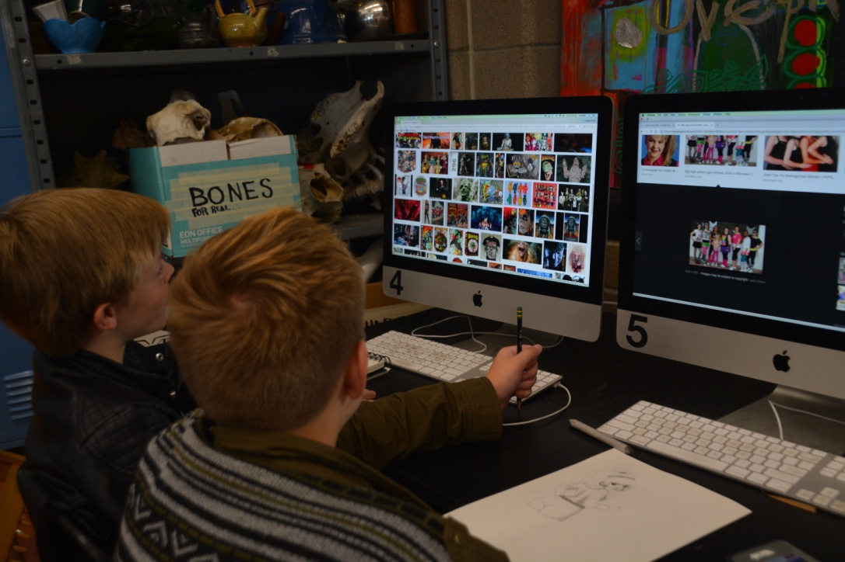
Frequently Asked Questions
If I live outside of Denver, are my chances less of getting in?
No. Our acceptances are made by the audition process

Slide 62
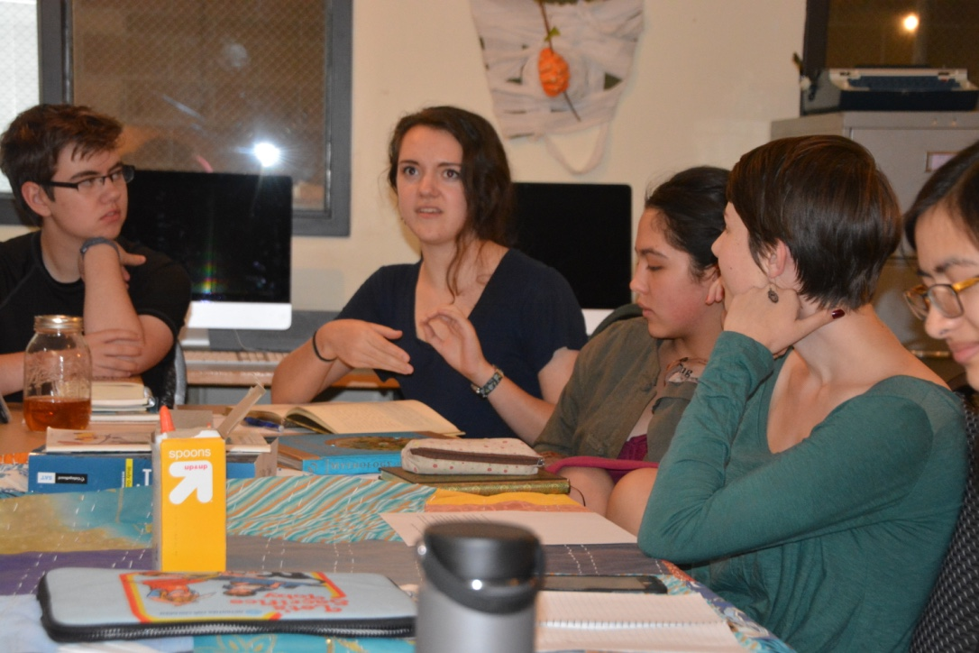
When will I find out?
Director of Admissions Miranda Odom will email you on Monday, February 10, 2020.
This email will have an accept, waitlist or not-qualified letter attached.

Slide 63
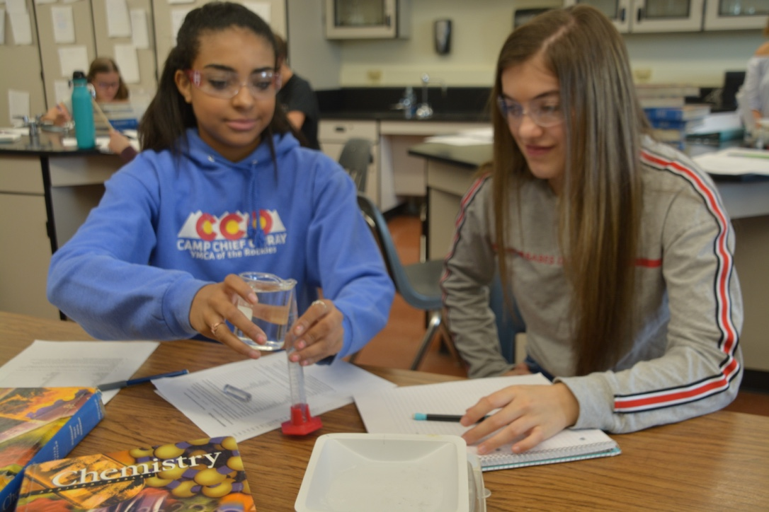
When will I find out?
The letters are not personalized as they are sent to hundreds of families within a matter of minutes.

Slide 64
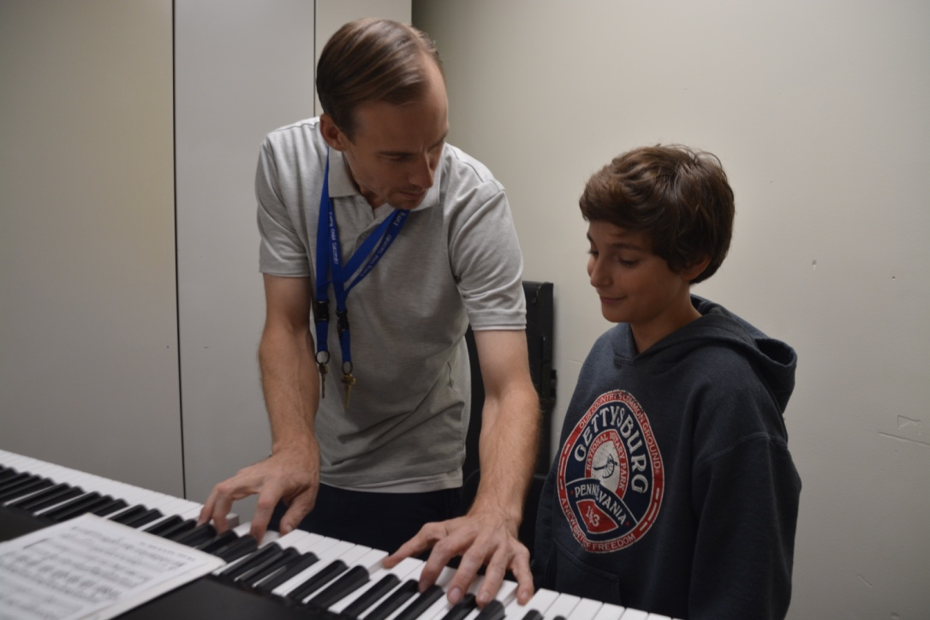
What if I’m waitlisted?
Go on with your school selection for 20/21 as if you’re NOT going to be taken off the waitlist.
If you are taken off the waitlist, Miranda Odom will email you. This will happen between March 2020 and August 31, 2020
We do not release the waitlist rank order

Slide 65
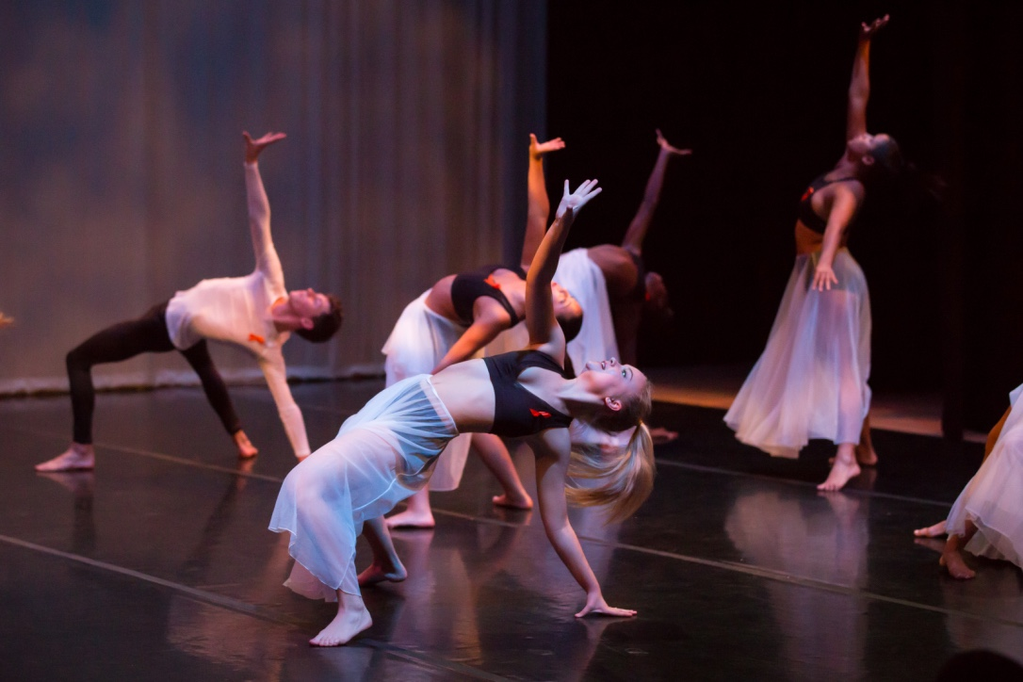
Will I receive feedback?
Because of the large quantity of students auditioning, we do not provide feedback to our applicants.

Slide 66
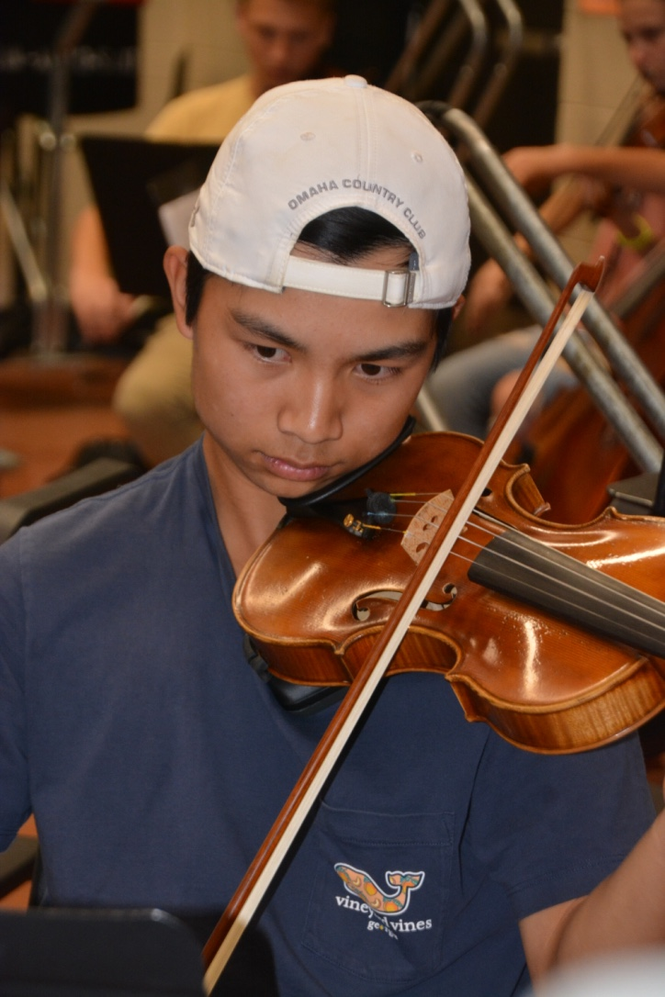
Can I change majors?
Change of Major process

Slide 67
Website
Let’s take a look

Slide 68
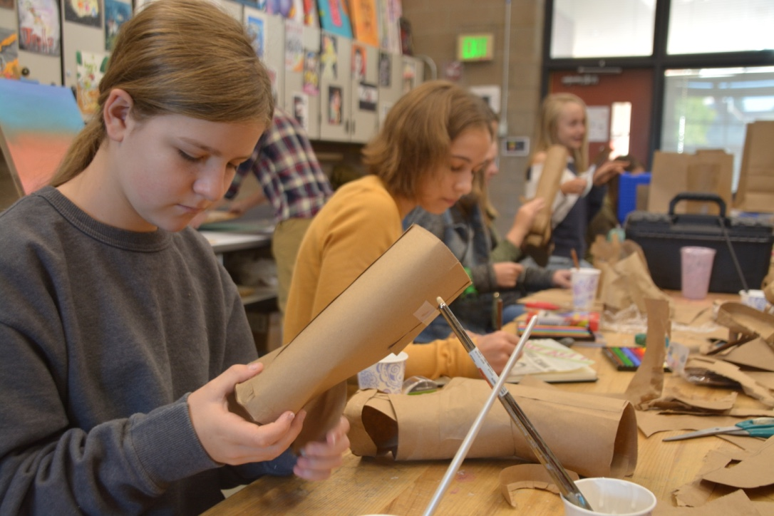
Phew! That was a lot of information
Remember – this powerpoint will be on the DSA website on December 11, 2019

Slide 69
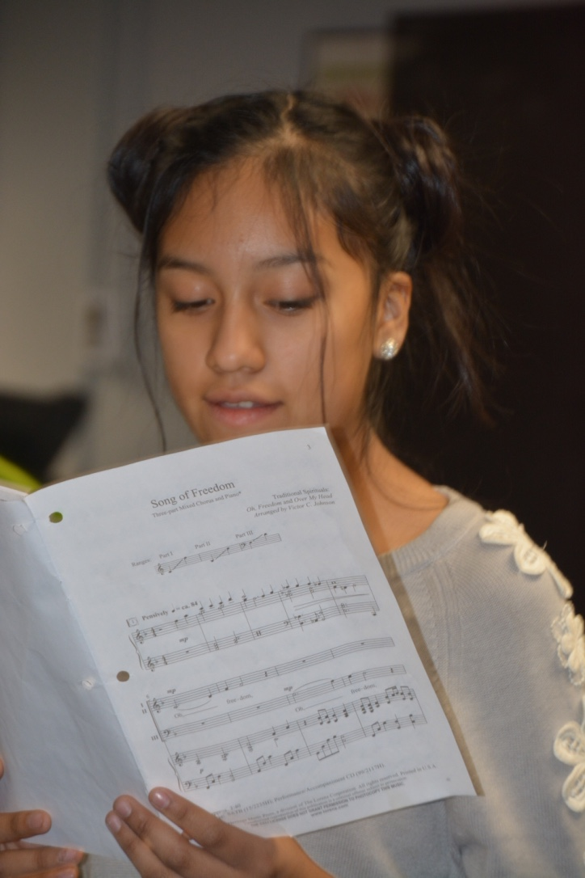
Questions
We cannot answer questions specific to auditions within a major.
These questions will all be addressed at the pre-audition meeting

Slide 70
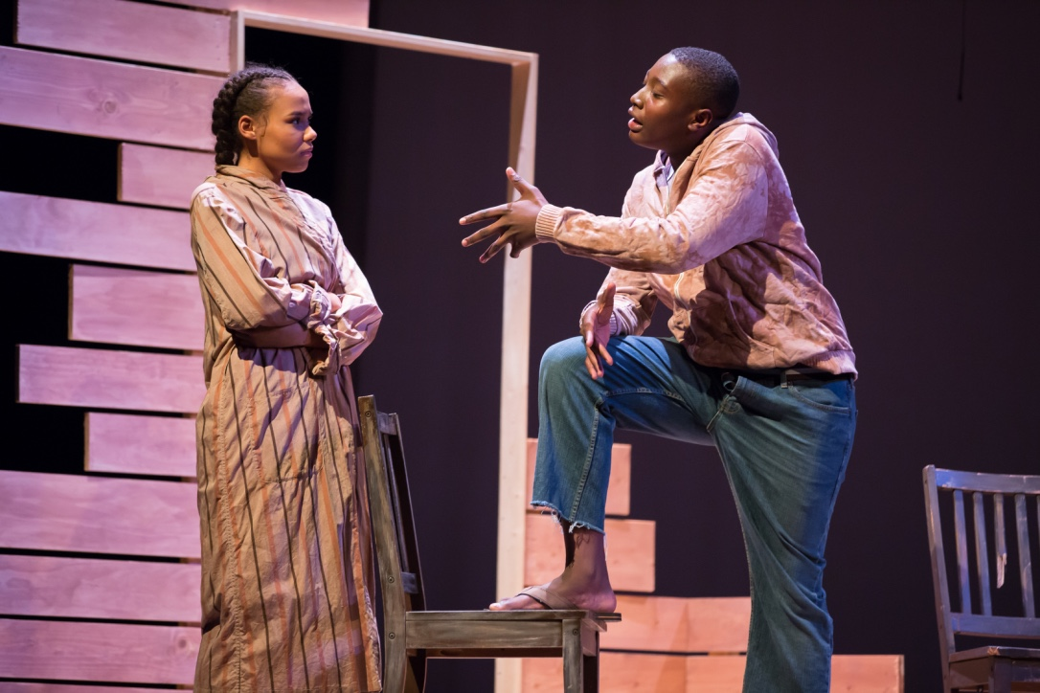
Tour
Thank you for attending today!
Assistant Principal Miranda Odom will split everyone into 11 major groups for a school tour.

